Slide 1
CloudFactory
Team 2
Chinmay Ajnadkar
Sri Abbirami Gnanasekaran
Urvi Bahety

Slide 2
OBJECTIVES
01
ERROR PREDICTION FROM LOG FILE
02
REAL-TIME ERROR DETECTION
03
VERIFICATION PROCESS FOR
CLOUDFACTORY

Slide 3
1. ERROR PREDICTION FROM LOG FILE
FROM LOG FILE
FROM DEMOGRAPHIC DATA
keytype_changed_no
mouseclick_button_no
Education
mousemove_distance_no
Experience
keytype_changed_time
Gender
mouseclick_button_time
mousemove_distance_time
work_duration
speed
13 *13 transition matrix

Slide 4
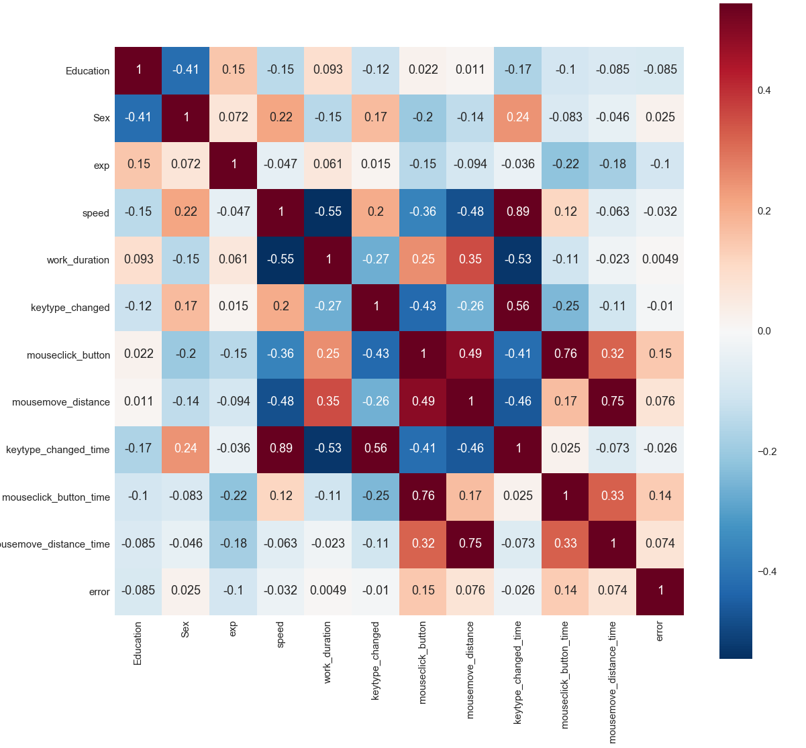
CORRELATION MATRIX

Slide 5
ALGORITHM
RANDOM FOREST CLASSIFIER
CONFUSION MATRIX
PREDICTION
TRUE POSITIVES
1
0
FALSE NEGATIVES
1
748
473
ACTUAL
0
208
1055
FALSE POSITIVES
TRUE NEGATIVES
PRECISION = 0.79
ACCURACY = 0.61
% INFORMATION GAIN = 15.99%
train_test_split = 0.5

Slide 6
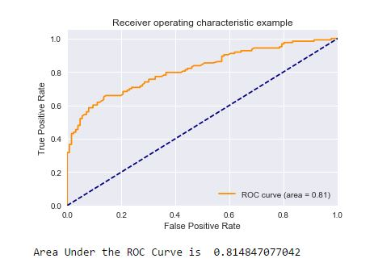
ROC CURVE
AREA UNDER ROC CURVE = 0.8148

Slide 7
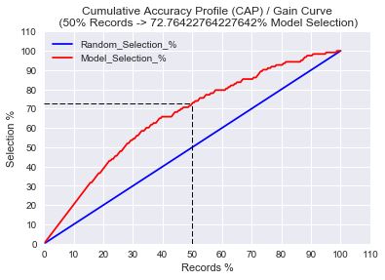
CAP CURVE
50% CAP CURVE PERFORMANCE = 73%

Slide 8
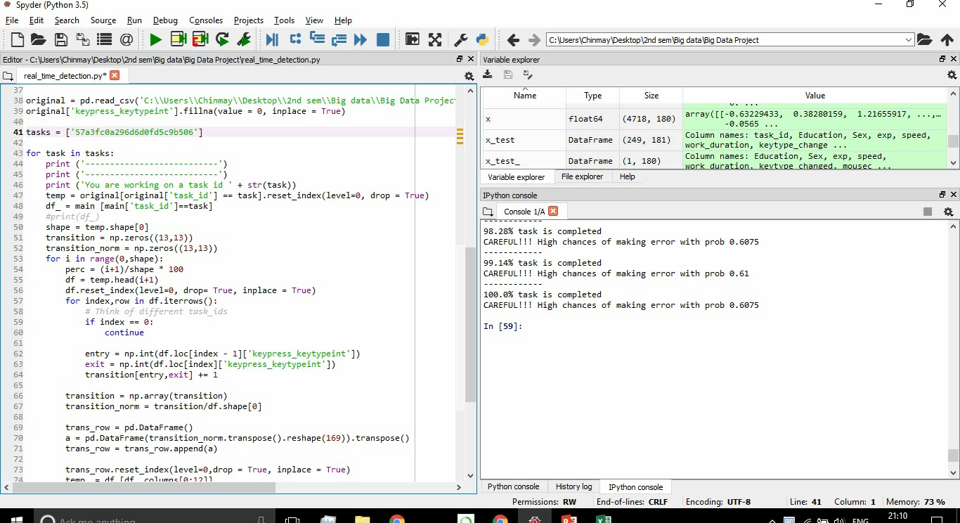
2. REAL-TIME ERROR DETECTION
PROBABILITY BOUNDRY = 0.65

Slide 9
COST FUNCTION ANALYSIS
CONFUSION MATRIX AT 50% TASK COMPLETION
Total no of task after 75-25 train-test split is 1242
PREDICTION
TRUE POSITIVES
1
0
FALSE NEGATIVES
1
485
107
ACTUAL
0
400
250
FALSE POSITIVES
TRUE NEGATIVES

Slide 10
COST FUNCTION EQUATIONS
For 25% Task Completion:
(1077*1.25*X) + (145*3*X) + (1077*(1.5+0.25) *Y) + (145*3*Y) = 1781.25*X + 2319.75*Y
For 50% Task Completion:
(885*1.5*X) + (357*3*X) + (885*2.0*Y) + (357*3*Y) = 2398.5*X + 2841*Y
For 75% Task Completion:
(562*1.75*X) + (680*3*X) + (562*2.25*Y) + (680*3*X) = 3023.5*X + 3304.5*X

Slide 11
Questions

